Slide 1
Nutritional Disorders Vitamins and Minerals (The Micronutrients)
Dr. Zainab A. Al-Mayyahi
Department of Medicine
College of Medicine
University of Basrah

Slide 2
Objectives
By the end of this lecture you should be able to
Define Vitamins
Classify vitamins
Identify causes of vitamins deficiencies
Describe the clinical features of vitamins deficiency and excess
Treat vitamin related nutritional disorders

Slide 3
Vitamins
are Biochemical substances that are required in human diet for optimal physiological functions.
Both deficiency and excess of vitamins can cause disease.
Vitamins deficiencies are most prevalent in developing countries but still present in developed countries.

Slide 4
Risk factors for vitamin deficiency
Malnutrition.
Older people.
Growing children .
Pregnancy.
Drugs.
Maldigestion
Malabsorption.
Alcoholics

Slide 5
Functions of Vitamins
Vital roles in different physiological processes e.g. coenzymes.
Some have pharmacological actions when given at supraphysiological doses e.g. Niacin and vitamin A.

Slide 6
Classifications of Vitamins
Fat soluble vitamins A, D, K, E (DEKA)
Water soluble vitamins C, B- complex group

Slide 7
Fat soluble vitamins (DEKA)

Slide 8
Vitamin A
Sources :
Animal source (Retinol): liver, fish, eggs.
Plant sources (B-Carotene): dark greens and colored vegetables and fruits.
Synthetic forms.
Daily requirements: 1.5 mg= 5000 IU/day.

Slide 9
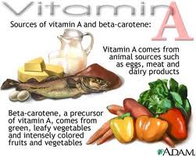

Slide 10
Functions of vitamin A
Night vision: retinaldehyde (retinal) is critical for rhodopsin in the rods of retina.
Growth and cell differentiation: retinoic acid.
Reproduction and embryogenesis.
Humeral immunity.
Hematopoiesis.
Antioxidant: B-Carotene.
Therapeutic role: acne , psoriasis, leukemia.

Slide 11
Vitamin A deficiency
Vitamin A is one of the most common causes of blindness in children around the world.
Causes of vitamin A deficiency:
Famine and under-nutrition.
Malabsorption
Obstructive jaundice.
Alcoholism.
Drugs e.g. cholestyramine.

Slide 12
Clinical features of vitamin A deficiency
Visual symptoms and signs:
Night blindness: impaired vision in dim light.
Xerophthalmia: dry lusterless cornea.
“Bitot’s spots” : glistening white plaques of desquamated conjunctival epithelium firmly adherent to underlying conjunctiva.
Keratomalacia: thinning and ulceration of the cornea, scaring and total blindness.

Slide 13
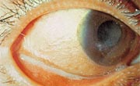
Xerophthalmia

Slide 14
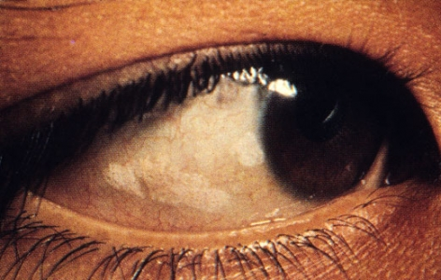
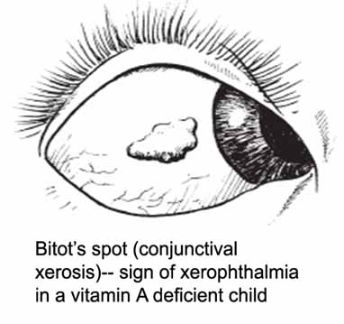
Bitot’s spots

Slide 15
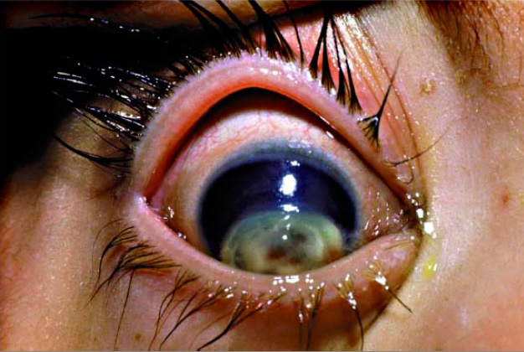
Keratomalacia

Slide 16
Other features of vitamin A deficiency
Increased susceptibility to infections.
Hyperkeratosis of the skin, acne, dry hair
Growth impairment in children
Fatigue , insomnia
Weight loss

Slide 17
Treatment of vitamin A deficiency
Treatment of underlying cause if present.
Encourage a vitamin A rich diet.
Vitamin A (retinol) supplements (60 mg= 200,000 IU in form of retinyl palmitate repeated after 14 days then every six months.
Eye surgeon referral if required.

Slide 18
Prevention of vitamin A deficiency
Encourage vitamin A rich diet.
Prophylactic oral dose of retinol 60 mg (200,000 IU) for pre-school children.
Fortification of food with vitamin A.

Slide 19
Vitamin A toxicity

Slide 20
Vitamin A toxicity
Two forms :
“Carotenemia” ; increased intake of B-Carotene
“Hypervitaminosis A” ; increased intake of retinol

Slide 21
Carotenemia
High level of B-Carotene is not toxic, it cause (Carotenemia) which is a yellow-orange discoloration of skin especially palms and soles “but not sclera” and this resolve after decreasing B-Carotene intake.
This can also occur in cases of hypothyroidism (decreased metabolism of B- Carotene)
Notes:
ke

Slide 22
Retinol toxicity (hypervitaminosis A)
- Two forms:
Acute toxicity
Chronic toxicity (hypervitaminosis A)

Slide 23
Vitamin A toxicity (acute)
Acute toxicity: ingestion of a single dose of 100- 150 mg of retinol will lead to abdominal pain , headache, vertigo, diplopia, bulging fontanels in children, seizures, and exfoliative dermatitis.

Slide 24
Chronic vitamin A toxicity
Chronic retinol toxicity occur if the daily intake is more than 15 mg=50,000 IU for more than three months.
Symptoms include: dry fissured skin, hair loss, headache, nausea , vomiting ( Increase intra-cranial pressure) hepatomegaly and bone pain.

Slide 25
Vitamin A toxicity treatment
Confirm diagnosis by measurement of level of vitamin A
Treatment is symptomatic and supportive.

Slide 26
Vitamin A and pregnancy
In high doses retinol is teratogenic
Pregnant women should not receive more than 3 mg/d of vitamin A (10,000 IU)

